Slide 1

Voting system Using Blockchain Members
Soni Kumari 40
Sumit Murkute 42
Dipanshu Awandkar 53
Nilesh Shinde 73
Under the guidance
Prof. Nikhil Kumthekar
Department of Computer Engineering
ISBM College of Engineering Nande , Pune
Academic Year : 2022-2023

Slide 2
AGENDA
Introduction​
Objectives
Motivation
Today’s need of the project
​Literature Survey
Block diagram
Feasibility study

Slide 3
Introduction
Elections are fundamental pillar of a democratic system enabling the general public to express their views in the form of a vote. Due to their significance to our society, the election process should be transparent and reliable so as to ensure participants of its credibility. Within this context, the approach to voting has been an ever evolving domain. This evolution is primarily driven by the efforts to make the system secure, verifiable and transparent. In view of its significance, continuous efforts have been made to improve overall efficiency and resilience of the voting system.
Blockchain is one of the emerging technologies with strong cryptographic foundations enabling applications to leverage these abilities to achieve resilient security solutions.
A Blockchain resembles a data structure which maintains and shares all the transactions being executed through its genesis. It is primarily a distributed decentralized database that maintains a complete list of constantly germinating and growing data records secured from unauthorized manipulating, tampering and revision.

Slide 4
Objective

Slide 5
Traditional voting system
inefficient
Takes time and human resources.
Does not give an instant Poll result.
Hard to track who voted and who don’t
Online Voting System
Instant Poll result
Easy to keep track of voters
Use of Internet

Slide 6
Movitation

Slide 7
Our main motivation in this project is to provide a secure voting environment and show that a reliable e-voting scheme is possible using blockchain. Because, when e- voting is available for everyone who has a computer, or a mobile phone, every single administrative decision can be made by people and members or at least peoples opinion will be more public and more accessible by politicians and managers. This will eventually lead humanity to the true direct democracy . Its important for us since elections can easily be corrupted or manipulated especially in small towns, and even in bigger cities located in corrupt countries
● Voter privacy
● Auditing uncertainties
○ Reduce electoral fraud
● Increase voter motivation

Slide 8
Today’s need of the project

Slide 9
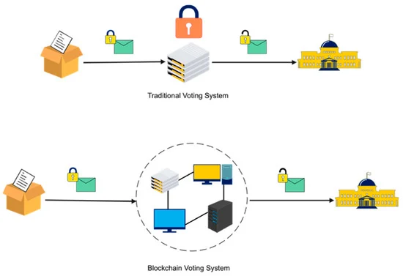
Blockchain technology fixed shortcomings in today’s method in elections made the polling mechanism clear and accessible, stopped illegal voting, strengthened the data protection, and checked the outcome of the polling. The implementation of the electronic voting method in blockchain is very significant [35]. However, electronic voting carries significant risks such as if an electronic voting system is compromised, all cast votes can probably be manipulated and misused. Electronic voting has thus not yet been adopted on a national scale, considering all its possible advantages. Today, there is a viable solution to overcome the risks and electronic voting, which is blockchain technology. In Figure one can see the main difference between both of the systems. In traditional voting systems, we have a central authority to cast a vote. If someone wants to modify or change the record, they can do it quickly; no one knows how to verify that record. One does not have the central authority; the data are stored in multiple nodes. It is not possible to hack all nodes and change the data. Thus, in this way, one cannot destroy the votes and efficiently verify the votes by tally with other nodes.

Slide 10
why
Enhanced credibility.
Less expensive.
Time saving and convenient.
Easy to vote.
Techno friendly
Speedy.
Low voter turnout.
No coercive voting.
Internet usage has increased.

Slide 11
Why blockchain-based e-voting?
In comparison to conventional voting methods, e-voting has enhanced the efficiency and the integrity of the process. Because of its flexibility, simplicity of use, and affordable costs compared to general elections, electronic voting is widely utilized in various ways during elections.
Despite this, existing electronic voting methods face the risks of running into over-authority and manipulated details, limiting fundamental fairness, privacy, secrecy, anonymity, and transparency in the voting process. Since e-voting procedures are centralized and licensed by the critical authority that controls, measures, and monitors the process in an electronic voting system, this is a problem that might hamper a transparent voting process. Recent controversies in modern democracies such as USA and India amplify this argument and prove it true.
It is essential to ensure that assurance in voting does not diminish. In this article, we will try to leverage blockchain to fix shortcomings in the voting method used in modern elections and make the polling mechanism clear and accessible to stop illegal voting, and strengthen the data protection to ensure a transparent outcome of the polling process. https://techblog.geekyants.com/e-voting-via-blockchain-a-case-study

Slide 12
FEATURES OF THE PROJECT
secured login procedure
Knowing nominees of respective wards
profiles can be modified
Nominees can post their vision
Casting vote is possible only with authentication of voter
Inspection is performed on both voter and nominees
Suspected user can be reported against
Abused user can be verified and blocked if necessary

Slide 13
LITERATURE SURVEY

Slide 14
There are lot of practices are made to introduce the variations in electronic and online voting systems where different techniques and methodologies are used. Some of them guarantees the confidentiality and security to the system at some extent, still the voting information and process need to be control and manage with advanced systems that will ensures and guarantees the security and privacy of voter’s and voter’s information.
The systems that are developed to caste the vote by means of digital approach using online portals and electronic devices use various encryption and decryption techniques to guarantee the secure data transaction.
However, numbers of techniques are present to convert the data in coded format to prevent from manipulation while transferring to the network. One drawback can be discussed here that after the correct data have been stored in the database trust and security is required at substantial level. Centralized storage is inconvenient ifthe data is esteemed because unauthorized access and attack by hackers will challenge the system in terms of reliability

Slide 15
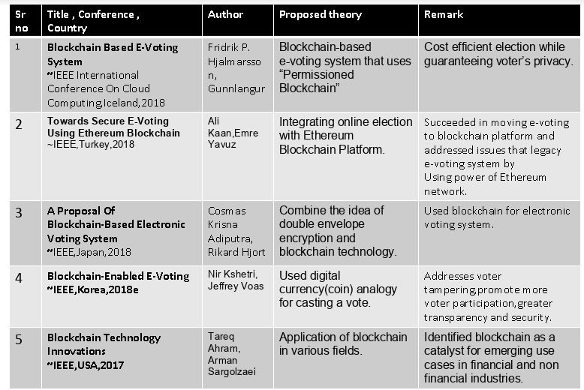

Slide 16
SCOPE
It provides website as well as app with related information to visitors.
It provides login facility to voters and admin.
Casting vote is possible only after authentication of voter.
Candidate for election can be registered.
Admin can generate result with a click

Slide 17
With the internet and blockchain,everything is changed.It’s the future of content.
“
”
Michael Caputo

Slide 18
Advantages
Disadvantages
Here are the advantages of conducting e-voting via blockchain:
Enhanced security as voting takes place over secure communication channels.
Low cost of setup as only the internet connection cost is required to vote across all the available e-voting platforms.
Accurate results and speed in the vote count.
Fraud prevention due to less human intervention at the polling stations.
Here are the disadvantages of conducting e-voting via blockchain:
Internet access is not available to everyone. In fact, in most developing nations around the world, majority of the people will be unable to afford internet facilities. There could also be issues as many people will not know how to use and access the web.
When voting via the blockchain, the voter has to log in by providing their personal and ID details, which can result in a “Voter Anonymity” issue.

Slide 19
Who can vote
As per the Indian Constitution, all Indian citizens above the age of 18 years who have registered themselves as voters are eligible to vote. These individuals can vote in national, state, district, as well as local government body elections.
Every voter is allowed one vote only.
A voter can vote at the constituency where they are registered. All voter-related information such as age, state, and constituency code is associated with the Aadhaar number.
Who cannot vote
If the voter ID the Adhaar ID does not exist in the contract list updated by the election commission.
When the voter’s constituency code does not match with ongoing election constituencies.
If the voter has already casted their vote once in their constituency.

Slide 20
The Voting Process
Login to the election commission website via your Aadhar number. It will provide you an OTP.
If the Adhaar does not exist in the contract i.e., the voter list and the voter's constituency code match with the ongoing election, it will show up in the election commission dashboard. Else the voters are not allowed to vote. If the election process is still going on, it will prompt you with the option to vote.
Click Vote -> Select Candidate -> Done.
Voters are not allowed to vote/update-vote to different candidates again.
The final candidates list with the vote count will be displayed after the election voting process is completed.

Slide 21
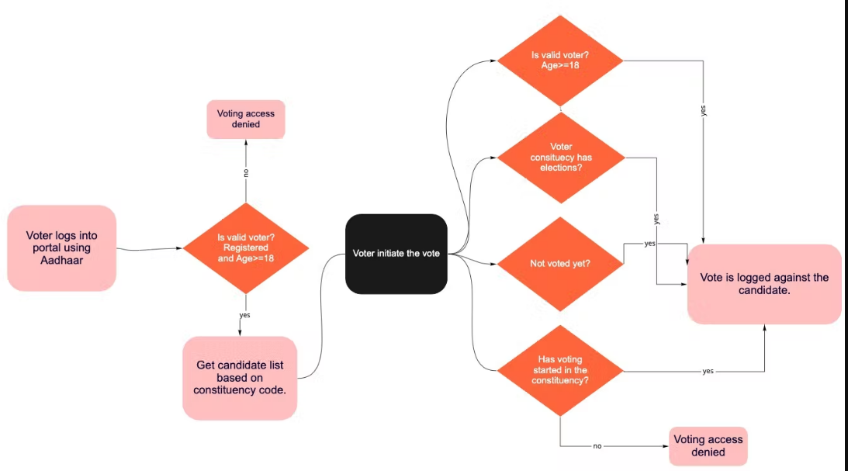
Smart contracts for e-voting.

Slide 22
Here's the proposed flow diagram based on the above assumptions, requirements, and process:
Entities
Voters
Candidates
Election Commission

Slide 23
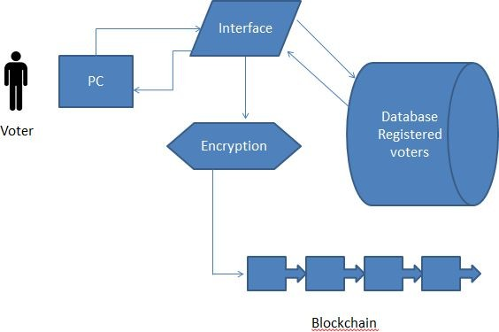
Architecture of Voting System
When determining on the architecture we took powerful inspiration from both the distributed and acquirability of the Bitcoin network and the gathering process of traditional voting. The network is a multi-tiered, decentralized infrastructure which having the two definite blockchains, the net- work is split into three abstract tiers, National, Constituency and Local. The local tier contains all the digital polling stations all over the country, each of which is connected to a constituency node. A local node is setup to only be in contact with the other local nodes under the connected constituency node and the constituency node itself.

Slide 24
Conclusion
Blockchain Technology is gaining popularity day by day. Using blockchain in voting system will help to achieve secure and cost-efficient election while guaranteeing voter’s privacy. Also, due to the encryption mechanism, it is impossible for any person to gain access to all the votes without first taking control of the entire service network.
The idea of adapting digital voting systems to make the public electoral process cheaper, faster and easier, is a compelling one in modern society. Making the electoral process cheap and quick, normalizes it in the eyes of the voters, removes a certain power barrier between the voter and the elected ofﬁcial and puts a certain amount of pressure on the elected ofﬁcial. It also opens the door for a more direct form of democracy, allowing voters to express their will on individual bills and propositions.

Slide 25
THANK YOU
ISB&M COLLEGE OF ENGINEERING
Prof. Nikhil Kumthekar
Prof.Balasaheb B.Gite

